Slide 1
DataTypes in MongoDB 161094 – Divansh Anupam

Slide 2
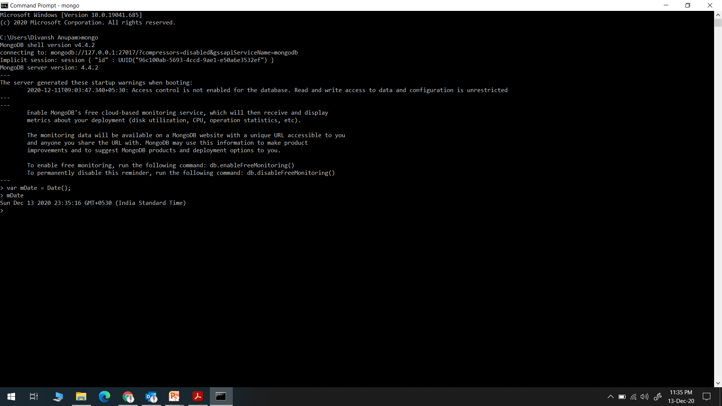
Date

Slide 3
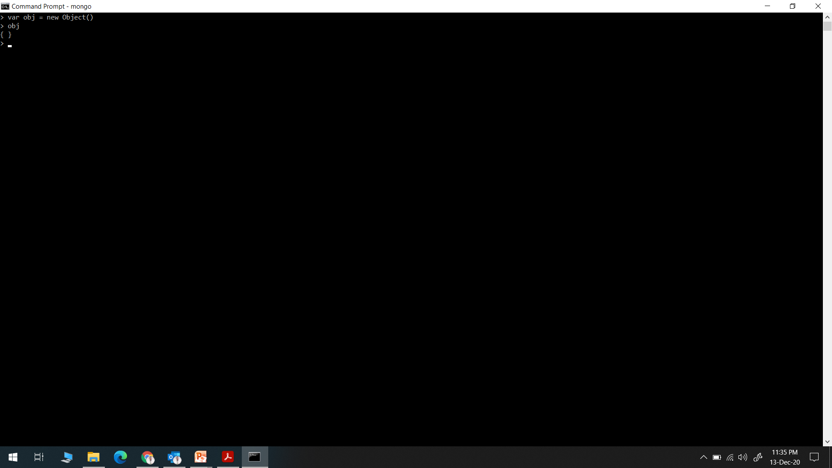
ObjectId

Slide 4
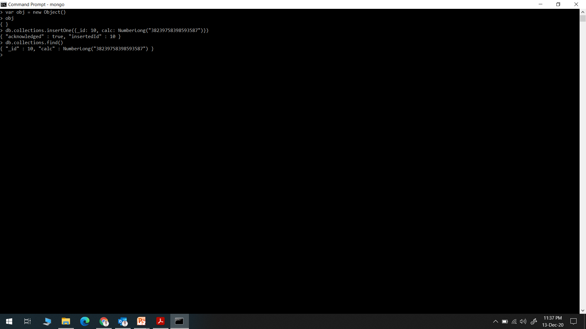
NumberLong

Slide 5
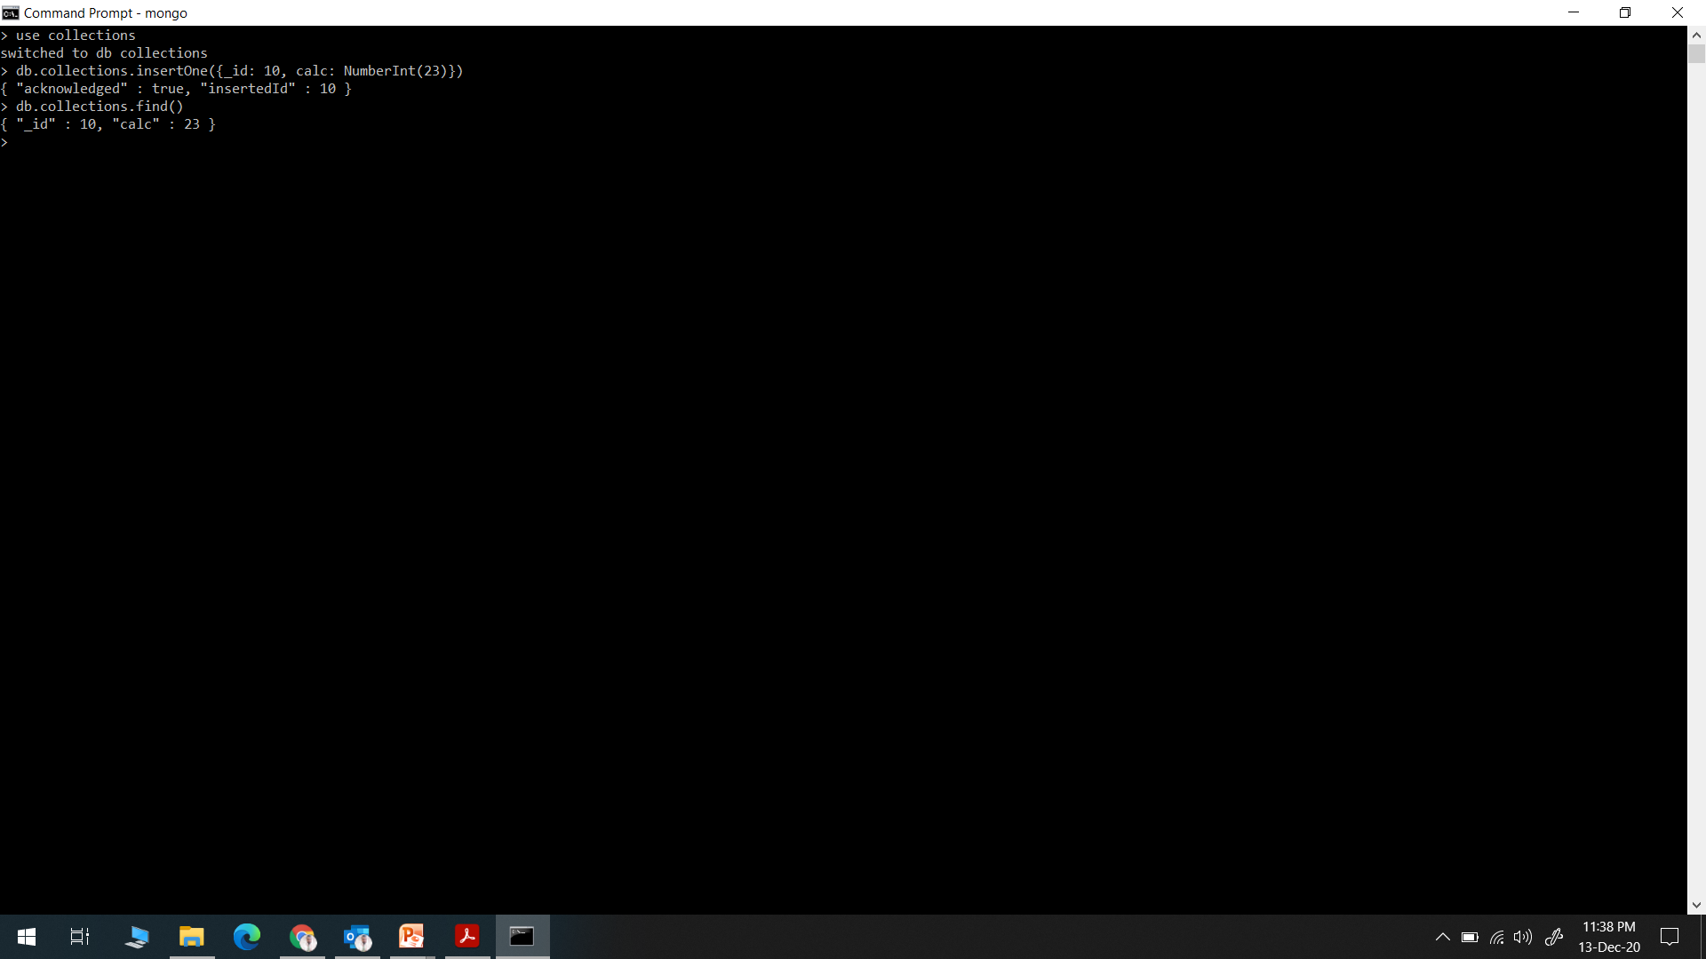
NumberInt

Slide 6
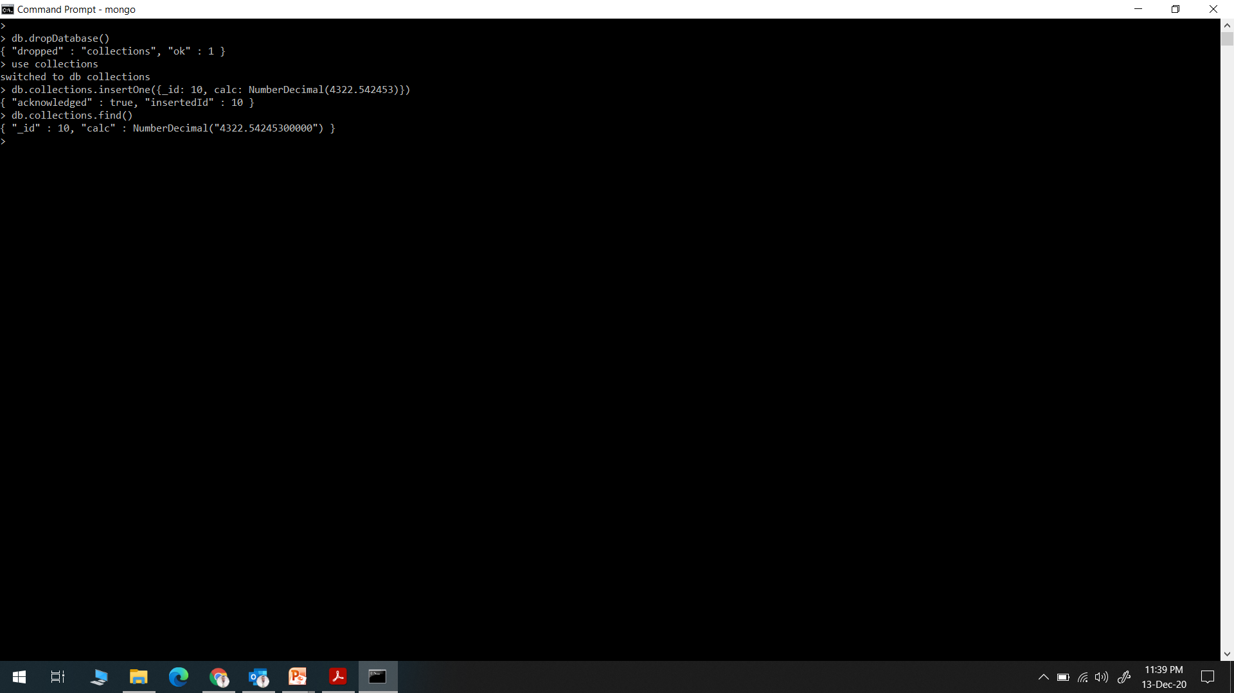
NumberDecimal

Slide 7
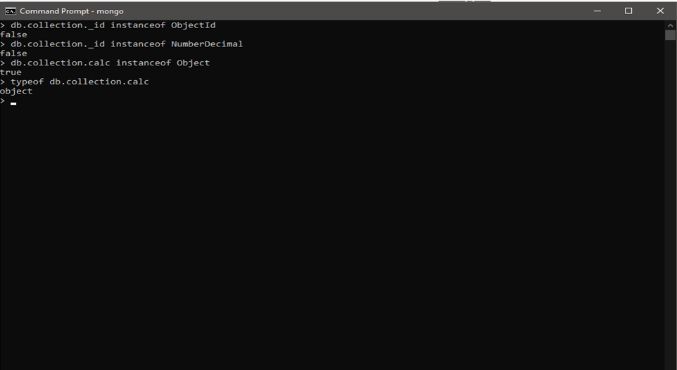
instanceOf & typeOf

